Slide 1
Problem Statement
Vehicle Movement Analysis and Insight Generation in a College Campus using Edge AI
- AI Architects

Slide 2
Unique Idea Brief (Solution)
Vehicle Movement Analysis and Insight Generation in a College Campus using Edge AI
This solution leverages Edge AI to provide comprehensive insights into vehicle movement and parking patterns on a college campus.
It combines vehicle movement analysis, parking occupancy monitoring, and vehicle matching to ensure efficient campus traffic management and security.
Vehicle Movement Patterns:
Analyze the frequency and timing of vehicle movement in and out of the campus.
Identify peak times and patterns.
The solution uses a dataset containing vehicle entry and exit times, along with Python libraries, to analyze the frequency and timing of vehicle movement.

Slide 3
Unique Idea Brief (Solution)
Parking Occupancy:
Monitor the occupancy of parking lots in real time.
Identify which parking lots are frequently occupied and at what times.
The solution uses a dataset containing vehicle occupancy, entry and exit times, parking images, and Python libraries to monitor occupancy and identify frequently occupied parking lots.
Vehicle Matching:
Match captured vehicle images and license plates to an approved vehicle dataset.
Identify unauthorized vehicles.
The solution utilizes license plate detection to compare against an approved vehicle dataset, flagging any unauthorized vehicles.

Slide 4
Features Offered
Analyze Vehicle Movement:
Analyze the frequency and timing of vehicle movements in and out of the campus.
Identify peak times and patterns.
Parking Occupancy Analysis:
Identify peak times and patterns of parking occupancy.
Monitor the occupancy of parking lots in real time.
Identify which parking lots are frequently occupied and at what times.
Vehicle Matching and Security:
Extract vehicle number plates.
Match captured vehicle images and license plates to an approved vehicle database and identify unauthorized vehicles.

Slide 5
Dataset
Parking lot images: Includes images depicting various parking lot occupancies.
Source: [YOLOv8 Parking Space Dataset]
Vehicle images: Consists of images showing vehicles with visible number plates.
Source: [Indian Vehicle Dataset on Kaggle]
Parking lot entry-exit dataset: Contains data on slot occupancies, occupancy timings, and vehicle entry-exit timings.
Source: Generated by ChatGPT
Authorized Vehicles dataset: Includes text data of authorized vehicle number plates.
Source: Manually curated number plate texts

Slide 6
Process flow – Vehicle Matching
Method: Retrieve_Number_plate
Class: NumberPlateRecognizer
Start
Convert Image to GrayscaleApply Bilateral Filtering
End
Initialize with Image Path
Load Image with OpenCV
Find Contours Identify License Plate Contour
Apply Canny Edge Detection
Create Mask for License Plate
Extract License Plate Region
Crop Image to License Plate Bounding Box
Perform OCR with EasyOCR
Extract and Clean Recognized Text
Return License Plate Number (Uppercase)

Slide 7
Process flow - Parking Occupancy
Class: ParkingSpace
Initialize: YOLO Model
Start
Method: parkingLotImg
Load and Resize Image
Perform Object Detection
Define Parking Areas
Check for Cars in Parking Areas
Calculate and Display Available Slots
Method: slotAnalysis
Aggregate Hourly Occupancy
Plot Hourly Occupancy
Calculate and Plot Average Occupancy Duration
Select Random Image
Read and Process CSV File
End

Slide 8
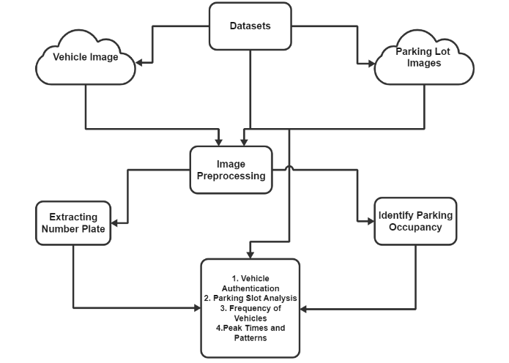
Architecture Diagram

Slide 9
Technologies used
Python 3.10.5
Jupyter Notebook
VS code
YOLO (You Only Look Once)
OpenCV
EasyOCR
Pandas
Matplotlib
Seaborn
Imutils
Numpy

Slide 10
Team members and contribution:
Thandram Venkat Reddy (Team Lead):
Mail-ID: venkatreddy00005@gmail.com | +91-8801564147
Vehicle Movement Patterns
Analyze the frequency and timing of vehicle movement in and out of the campus.
Identify peak times and patterns.
Vehicle Matching (Authorization)
Match captured vehicle images and license plates to an approved vehicle dataset.
Identify unauthorized vehicles.
Karnekota Sai Kiran (Team Member):
Mail-ID: saikirankarnekota@gmail.com | +91-8341029955
Parking Occupancy
Monitor the occupancy of parking lot.
Identify which parking lots are frequently occupied and at what times.

Slide 11
Conclusion
This Edge AI-based solution for vehicle movement and parking offers a significant advancement in managing college campuses. By leveraging real-time image processing and data analysis, the system provides valuable insights into:
Vehicle Movement Patterns
Parking Occupancy
Vehicle Matching
This intelligent system promotes smoother traffic flow, improves parking efficiency, and strengthens campus security, creating a safer and more manageable environment for students, faculty, and staff. The implementation of this Edge AI solution can be a cornerstone for developing a smart campus, fostering a more streamlined and secure academic experience.

